Slide 1
Smart Phone Barometric Map
Members:
Dayreal Brown Xuanchen Xiang
Robert Minter Ziheng Zhang

Slide 2
Problem:

Slide 3
Problem:

Slide 4
Potential:

Slide 5
Our Solution:

Slide 6
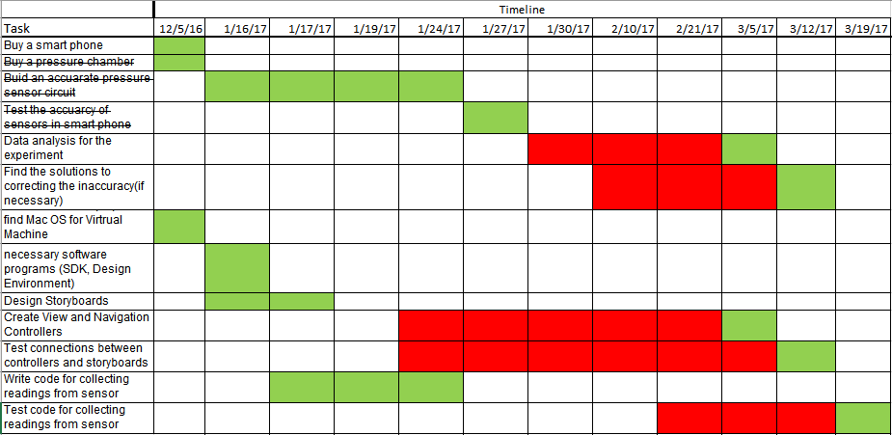
Gantt Chart

Slide 7
Electrical Part
Test Accuracy
Pressure
Chamber
Pressure
sensor

Slide 8
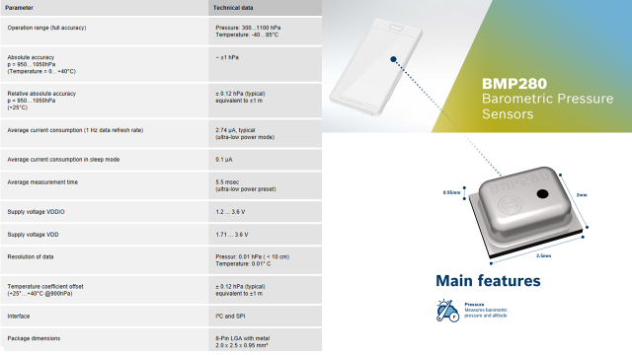
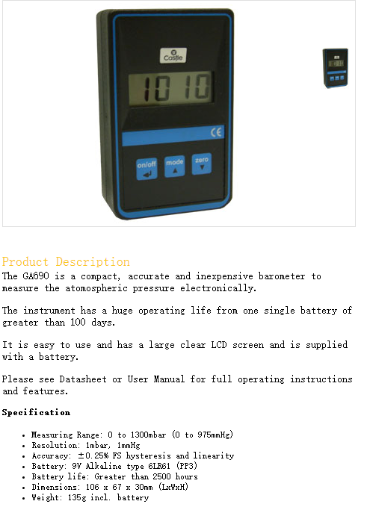

Slide 9
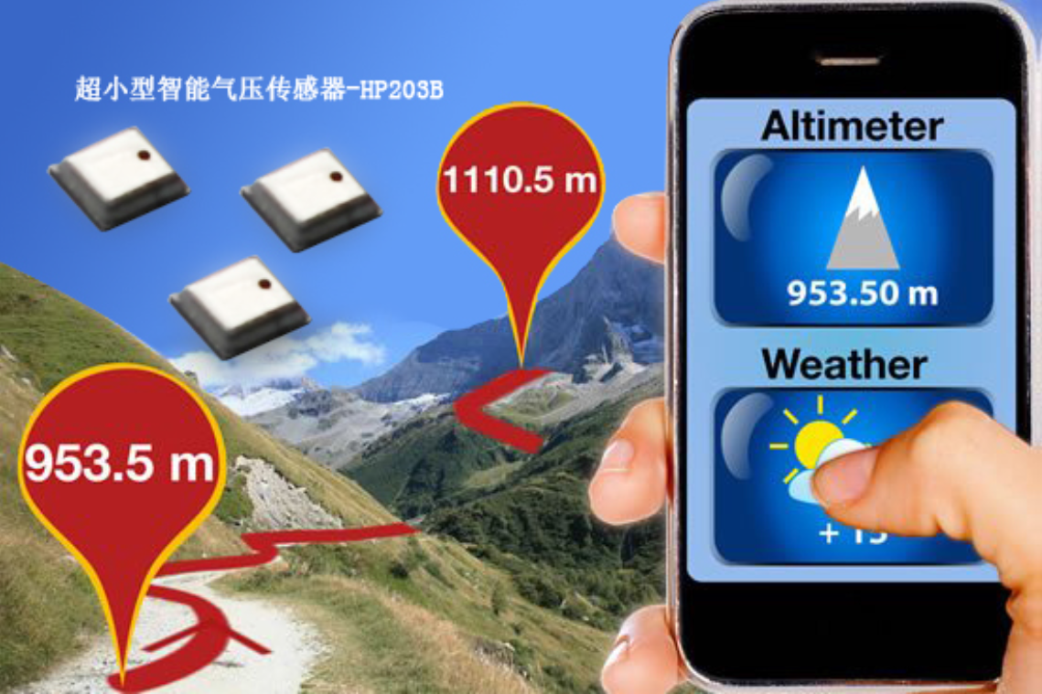
What do we want to make?
Pressure map
What do we need?
Data
What should data be like?
Data should be updated every 10 min and pressure error should be within 1 mb

Slide 10
Pressure Map

Slide 11
Pressure
Map
Temperature
Height

Slide 12
Height
Laplace pressure formula
a=1/273
T: temperature
P:Pressure
Z:Height
Only for ideal condition

Slide 13
Temperature
Temperature changes with the Height
Fourier's law of heat conduction
Assume temperature value is continuous
use Statics equations and do the calculation
Suppose there is no heater

Slide 14
Temperature
Model Temperature and Height linearly
Suppose Temperature is in a state of instability
Use Fourier's law of heat conduction
When Z=h

Slide 15
Temperature
Atmospheric short-term state change is not big, we can consider it quasi static and adiabatic
the first thermodynamic law
state equation
We got
When
Just for short distance
Do the calculation

Slide 16
Example 02/19/2017 21:53
Tallahassee：
Height：62m（constant）
Pressure：1019.6 mb
(we are in Tally
we can know the pressure at any time
By using pressure meter)
Temperature: 17.2 degree C
Jacksonville
Height：4.9m（constant）
Pressure：？Mb（1018.6）
Temperature: 18.9 degree C
P=1018.8 MB
Error :0.2 mb

Slide 17
Testing Data
Xuanchen Xiang

Slide 18
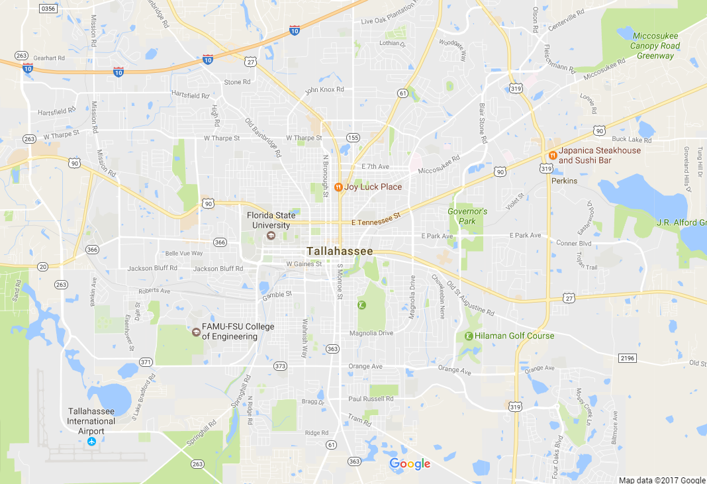
Choose Testing points
Florida State University:
Latitude: 30.441878N
Longitude: 84.298489W
Altitude: 24.052m/78.911ft

Slide 19
Accuracy & Usability
Time: Morning, noon, night...
Weather stations: get history data from several different weather stations.
Regions: water area, high way, residential area, forest, grassland...
Weather: sunny, cloudy, rainy, windy...
Make the database as large as possible.

Slide 20
Indoors & Outdoors
Indoor Test
Accurate?
Yes
No
Don't need indoor data testing
The system needs to figure out the data and integrate them separately.

Slide 21
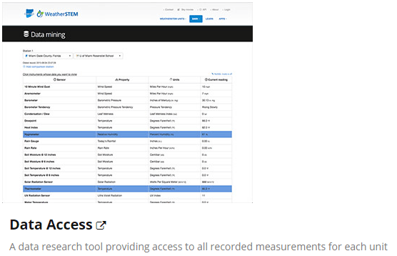
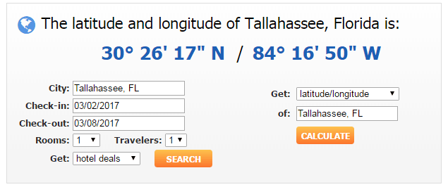
Sample Data

Slide 22
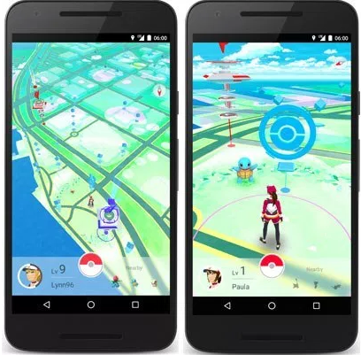
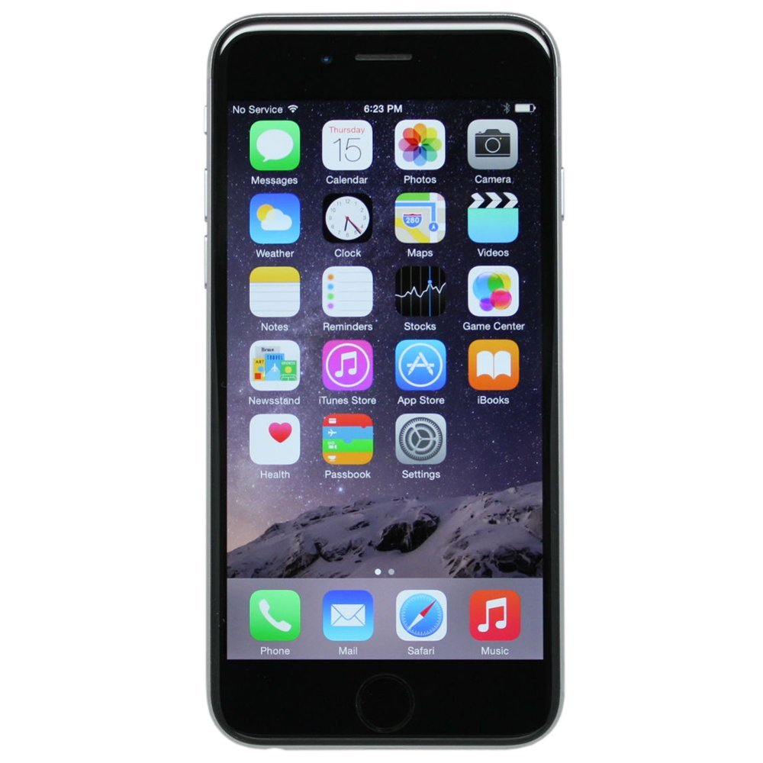
What do we do using the data?
GPS
Weather stations
Smartphone sensor
Wind Data

Slide 23
Module – Application Interface
FrontPage of the application that the user will see when using the app
Develop using Xcode

Slide 24
Module – Application Backend
Database to record readings from app
Develop using MySQL
Need to have PHP connection
Notes:
http://stackoverflow.com/questions/9509419/xcode-easiest-way-to-send-data-from-ios-textfield-for-example-to-a-remote-datab

Slide 25
Remaining Hurdles
Putting the application onto the phones for testing
Implementing and Testing the pressure algorithm

